Slide 1
Safe Selly

Slide 2
Why?
Students want info!
Peace of mind walking home.
Need for accurate data.

Slide 3
Our solution
Easily accessible emergency contact details.
Integration with google maps to visualise crime data.

Slide 4
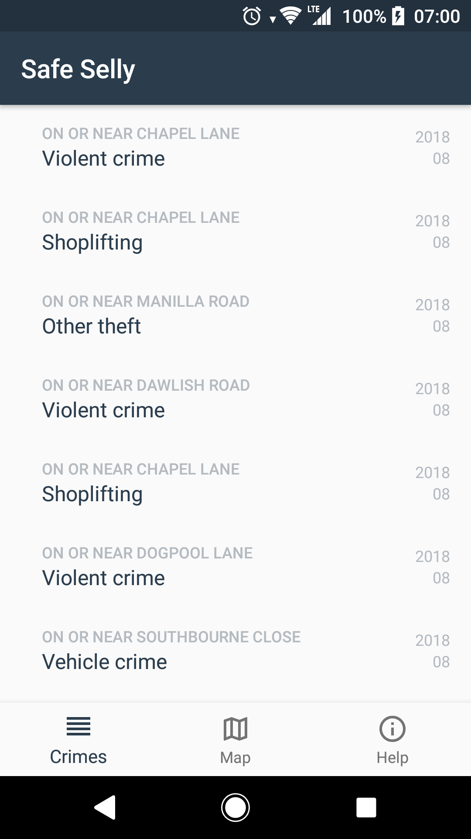
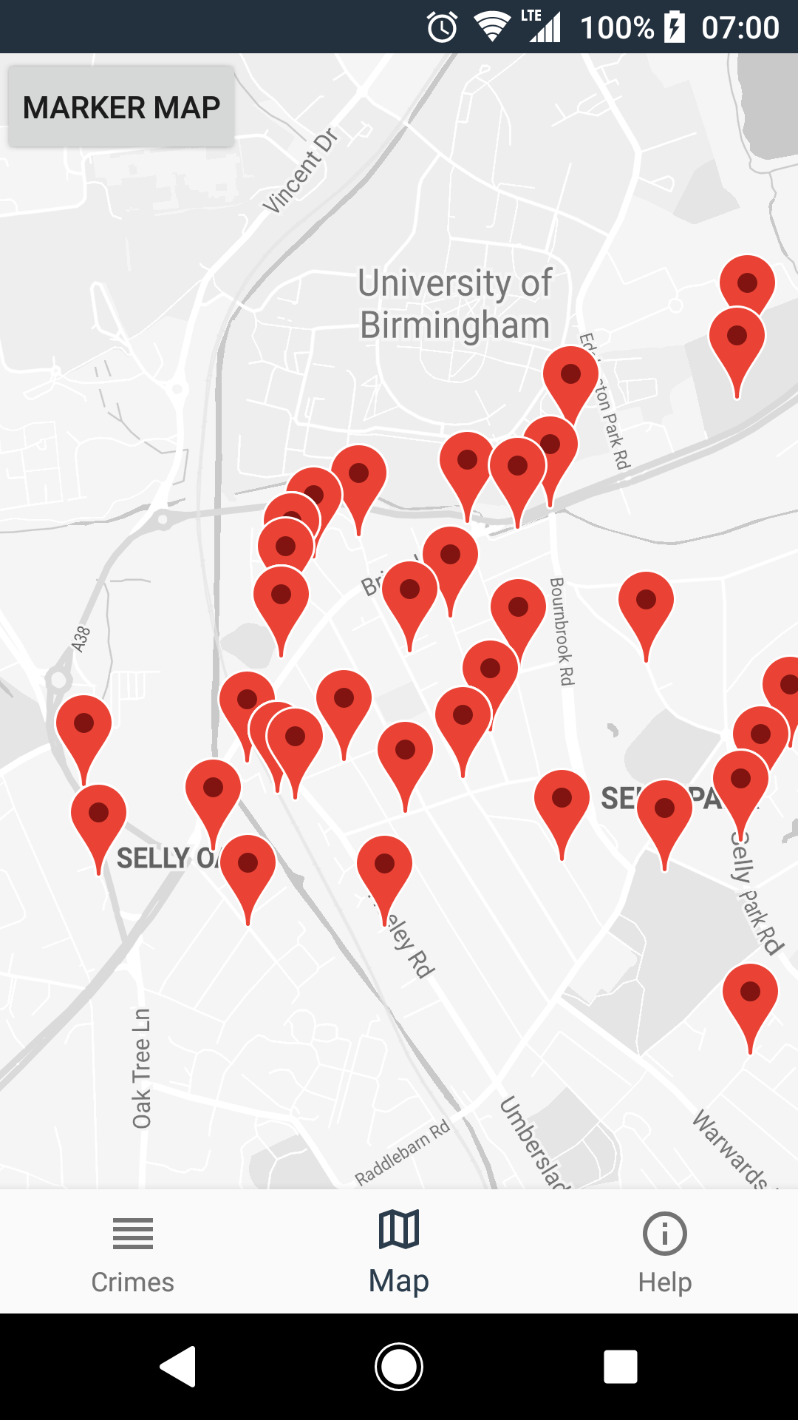
Track crime rates

Slide 5
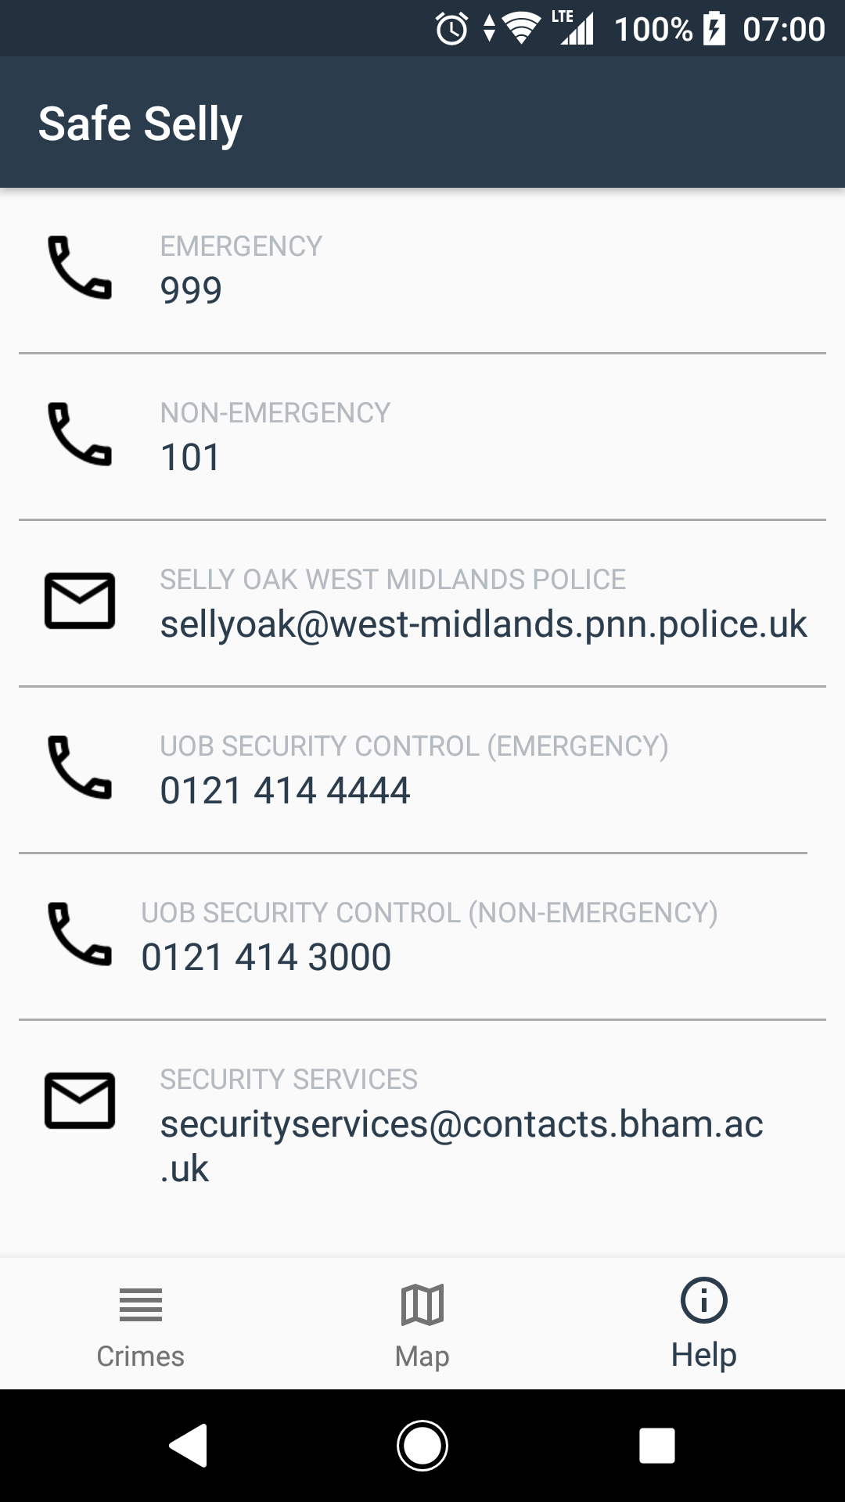
Emergency information

Slide 6
Next steps
Heat map showing crime intensity
Emergency contacts
Individual crime details
Integrate further with google maps to advise on safest route home

